Slide 1

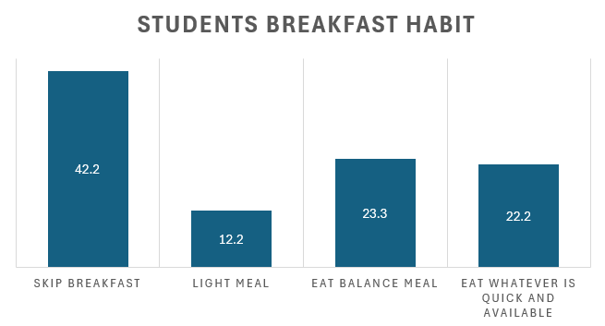
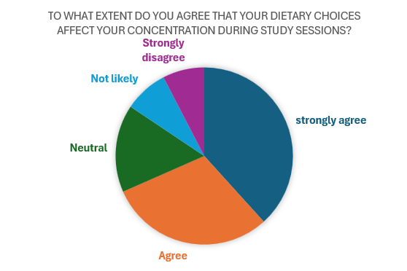
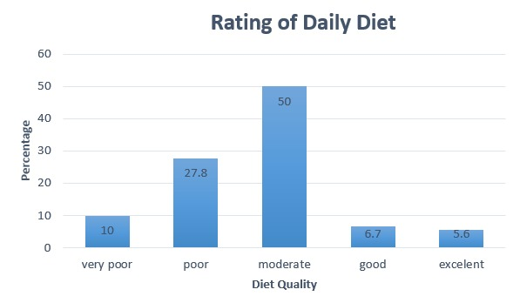
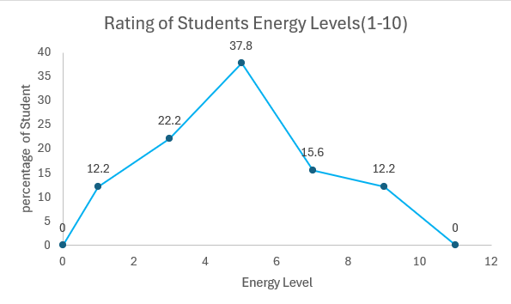
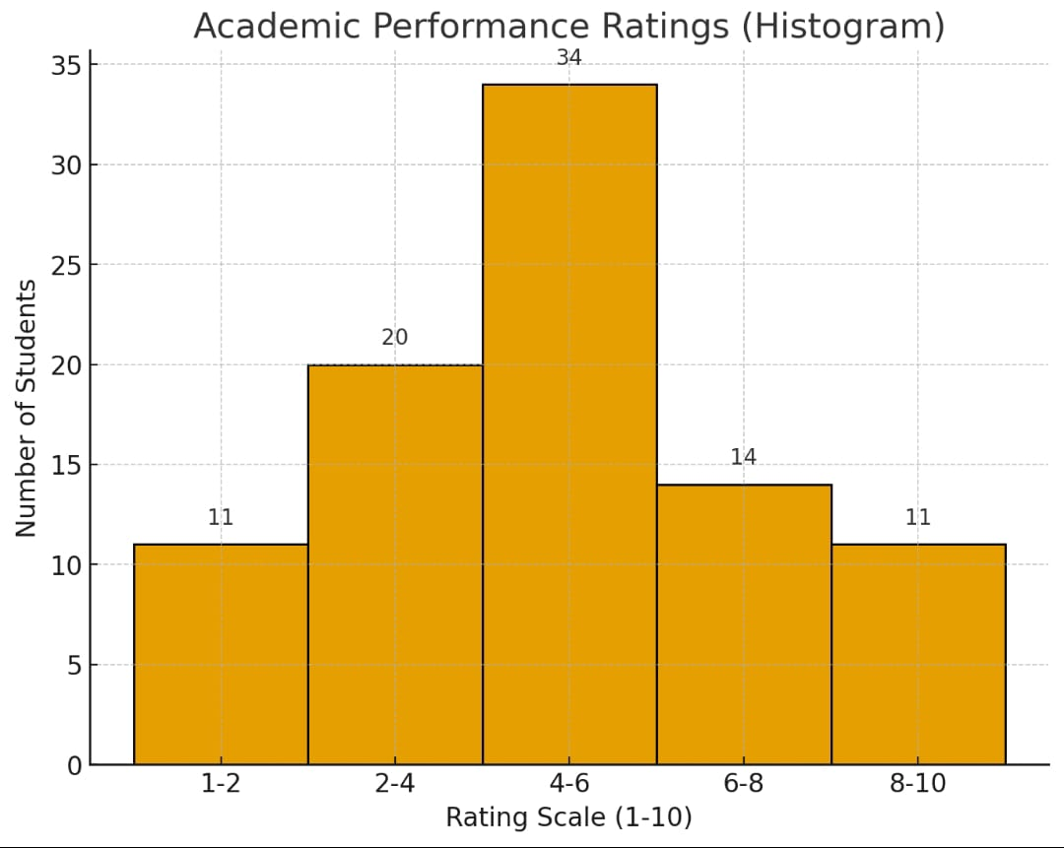
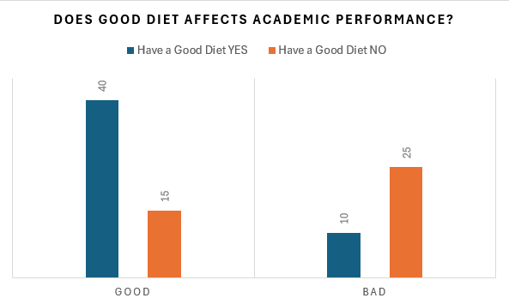
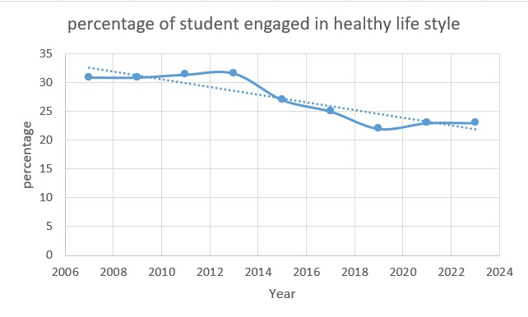
The Student Plate: Balancing Nutrition and Lifestyle
Group: 06 | SECTION: D
Ananta Saha, Arghya Das, Anyka Akter Ayna, Istiak Raihan Bhuiyan, Md Shahriar Hossain.
Course Instructor:
FATEMA TUZ ZOHRA
ABSTRACT
INTRODUCTION
Methodology
This presentation explores the nutritional habits of students, examining how their dietary choices impact their academic performance and physical health.
A balanced diet gives students the fuel their body and mind need to perform at their best. When combined with enough sleep, regular exercise, and healthy stress management, it creates a strong foundation for overall well-being. Eating the right mix of nutrients improves focus, memory, and academic performance, boosts energy, supports growth, and lowers the risk of future health problems.
A survey was conducted among 90 students to study their nutritional habits and lifestyle balance. The questionnaire focused on meal patterns, dietary quality, energy levels, and their perceived impact on academic performance and health. Collected data were analyzed in Excel, with key findings presented through graphs and charts. Additionally, hypothesis testing and basic forecasting techniques were applied to identify trends and potential future changes in student performance.
Results
discussion
Many students skip breakfast or eat fast food. This can make them feel tired and have less focus.
Most students say their daily diet is medium. They could eat healthier food.
Students with low or medium energy often have medium grades. This shows diet can affect school performance.
HYPOTHESES
FORCASTING
Based on the data from 2007 to 2023 showing a declining trend in the percentage of students engaged in healthy lifestyle habits due to dietary factors (from 30.9% in 2007 to 23.0% in 2023), a continued decrease is projected. Using a polynomial trendline, the engagement is expected to drop further, potentially reaching approximately 20% by 2028, assuming current dietary and lifestyle pressures persist. This suggests a growing challenge in balancing nutrition and lifestyle among students, necessitating targeted interventions.
H₀ :Good diet does not affect academic performance.
H₁: Good diet affects academic performance.
Chi Square Test Result : 16.87> 3.84 (Rejected)
So, Good diet affects academic performance.
DATA SOURCE
Conclusion
A total of 90 students participated in this study on balancing nutrition and lifestyle. Participants came from various occupational backgrounds:
Students: 96.7% Others: 3.3%
Primary data was collected via Google Forms, while secondary information was obtained from online studies. All data were analyzed using Microsoft Excel, and insights were presented through graphs and visual charts. Participant confidentiality was strictly maintained, and consent was taken before data collection.
The data shows that students’ eating habits strongly affect their health and studies. Many skip breakfast or choose quick, unhealthy food, which lowers energy and focus. Most students rate their diet as only “moderate,” and this is linked with more fatigue and weaker academic results. If these habits continue, healthy lifestyles may drop further in the future. The biggest barriers for students are lack of time to prepare meals and the high cost of nutritious options. Still, many students want to improve, so support and guidance are needed to help them eat better and perform well.
Reference
[1]. 2023 YRBS Results: Latest survey highlights on student behaviors, including sleep and safety concerns.https://www.cdc.gov/yrbs/results/2023-yrbs-results.html
[2]. Adapted from CDC YRBS and nutritional health studies.

